Slide 1

Here’s a test for Sarah

Slide 2
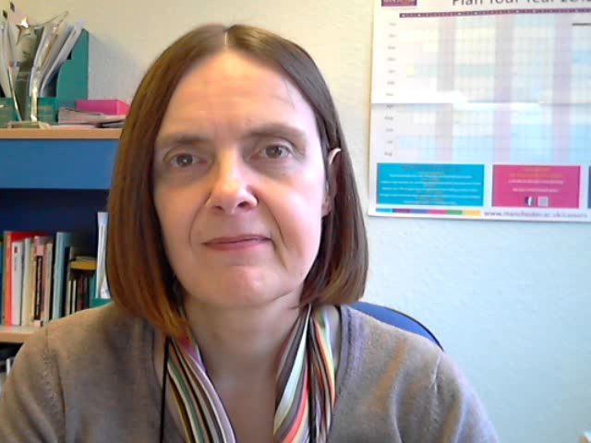
Now it gets scary ...

